Slide 1
Git
A distributed version control system

Slide 2
Agenda
What is Git and Why Git
Git Basics
Git Branching
Git Workflows
Git on the server
Git & Github
Git VS. SVN
Referrences

Slide 3
What is Git and Why Git
Git /ɡɪt/ is a distributed revision control and source code management (SCM) system with an emphasis on speed.
  Distributed development
  Cheap branching and merging
  More flexible workflows
  Git is Fast

Slide 4
Git Basics - Download & Install
There are online materials that are better than any that I could provide
Here’s the standard one:
http://git-scm.com/downloads
Here’s one from StackExchange:
http://stackoverflow.com/questions/315911/git-for-beginners-the-definitive-practical-guide#323764

Slide 5
Git Basics - Introduce yourself to Git
Enter these lines (with appropriate changes):
  git config --global user.name "Youming"
  git config --global user.email ming.you@hp.com
You only need to do this once
If you want to use a different name/email address for a particular project, you can change it for just that project
  cd to the project directory
  Use the above commands, but leave out the --global

Slide 6
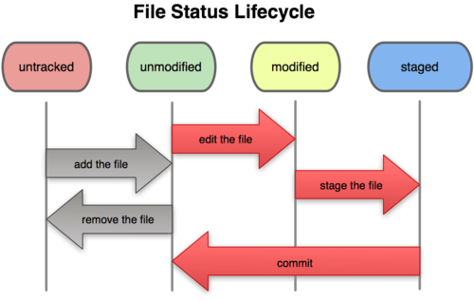
Git Basics - File Status Lifecycle

Slide 7
Git Basics
git init - initializes a directory as a Git repository
git status - view the status of your files in the working directory and staging area
git add- adds file contents to the staging area
git diff - shows diff of what is staged and what is modified but unstaged
git commit- records a snapshot of the staging area
git rm - remove files from the staging area
git mv - git rm --cached orig; mv orig new; git add new
git log - show commit history of a branch
Notes:
git init
git status
git add <file>
git diff (show diff of unstaged changes) / git diff –cached or git diff –staged (show diff of staged changes) / git diff HEAD (show diff of all staged or unstaged changes)
git commit –m / git commit –a –m / git commit –amend
git rm <file> / git rm --cached <file> want to keep the file on your hard drive but not have Git track it anymore. May add to .gitignore
git mv = git rm --cached orig; mv orig new; git add new;
git log / git log -p -2 / git log --stat

Slide 8
Git Basics - Undoing Things
Unstaging a Staged File
git reset HEAD <file>
Unmodifying a Modified File
git checkout -- <file>
note: git checkout -- is dangerous.
May be git stash is better.
Notes:
git reset HEAD <file> // unstaging a staged file
git checkout -- <file> // unmodifying a modified file `dangerous` maybe git stash is better

Slide 9
Git Basics - Working with remotes
git clone URL - copy a git repository
git remote - list, add and delete remote repository aliases
git fetch - download new branches and data from a remote repository
git merge - merge a branch context into your current one
git pull - fetch from a remote repo and try to merge into the current branch
git push - push your new branches and data to a remote repository
Notes:
git clone URL
git remote –v / git remote add [alias] [url] / git remote rm [alias]
git fetch [[repository] [refspec]…]
(repository:remote alias refspec:+<src>:<dst> +is optional, <src>means remote branch, <dst>means local branch)
eg: git fetch origin
[remote "origin"]
url = git@github.com:schacon/simplegit-progit.git
fetch = +refs/heads/*:refs/remotes/origin/*
The format of the refspec is an optional +, followed by <src>:<dst>, where <src> is the pattern for references on the remote side and <dst> is where those references will be written locally. The + tells Git to update the reference even if it isn’t a fast-forward.
git merge [alias]/[remote-branch]
eg: git merge origin/master
git pull [[repository] [refspec]…]
(repository:remote alias refspec:+<src>:<dst> +is optional, <src>means remote branch, <dst>means local branch)
eg:git pull origin
git push [[repository] [refspec]…]
(repository:remote alias refspec:+<src>:<dst> +is optional, <src>means local branch, <dst>means remote branch)
eg:git push origin master (means use local master branch to update remote(origin)’s master branch)

Slide 10
Git Basics - Taging
Listing Your Tags
  git tag
Creating Tags
  git tag –a v1.3 –m "my version 1.3"
  Showing Tag data along with commit
  git show v1.3
Tagging Later
git tag –a v1.2 –m 'version 1.2' [commit]
Sharing Tags
git push origin [tagname]
Notes:
Listing Your Tags
git tag
Creating Tags
git tag –a v1.3 –m “my version 1.3”
Showing Tag data along with commit
git show v1.3
Tagging Later
git tag –a v1.2 –m ‘version 1.2’ 9fceb02
Sharing Tags
git push origin v1.5
git push origin --tags

Slide 11
Git Basics - Tips and Tricks
Git command Auto-Completion for Bash shell
  For yourself
  cp contrib/completion/git-completion.bash ~/.git-completion.bash
  echo "source ~/.git-completion.bash" >> ~/.bashrc
  For all users
    cp contrib/completion/git-completion.bash /etc/bash_completion.d/
Git Aliases
  ~/.gitconfig
  From -> https://github.com/dorayo/dotfiles.git

Slide 12
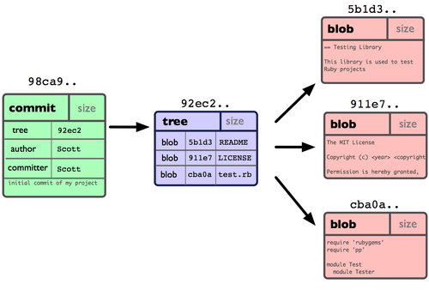
Git Branching - What a Branch Is(1)
Single commit repository data
Notes:
$ mkdir branch-test
$ cd branch-test
$ git init
$ echo "README" > README
$ echo "test.rb" > test.rb
$ echo "LICENSE" > LICENSE
$ cd .git/objects ; ls; cd ../../
$ git add README test.rb LICENSE
$ cd .git/objects; ls;
$ git commit -m 'initial commit of my project'
$ git log
$ git cat-file –p 39c3a4626217dc5f0a9488024fe833dada5e51b5 ; git cat-file -p 99331788a2b4b00c13d5a7fff53d9829f50ca05a

Slide 13
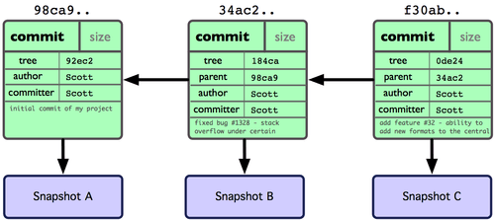
Git Branching - What a Branch Is(2)
Git object data for multiple commits
Notes:
$ echo "fixed bug #1328" >> README
$ git commit -a -m "fixed bug #1328 - stack overflow under certain condition"
$ echo "add feature #32" >> README
$ git commit -a -m "add feature #32 - ablility to add new formats to the centrol“
$ git log
$ git cat-file -p [object-sha1]

Slide 14
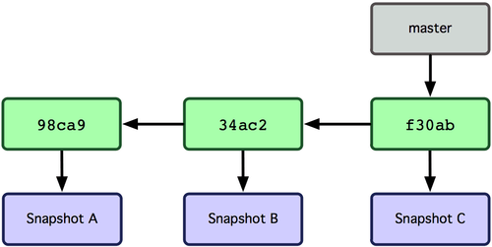
Git Branching - What a Branch Is(3)
Branch pointing into the commit data 's history
Notes:
$ cd .git/refs/heads/
$ cat master
$ git log | head

Slide 15
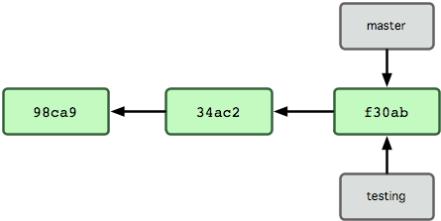
Git Branching - What a Branch Is(4)
Multiple branches pointing into the commit's data history
Notes:
$ cd ../../../
$ cd .git/refs/heads/
$ ls
$ cat testing
$ git log | head

Slide 16
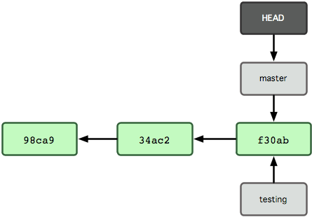
Git Branching - What a Branch Is(5)
HEAD file pointing to the branch you are on
Notes:
$ cd ../../../
$ cd .git
$ ls
$ cat HEAD

Slide 17
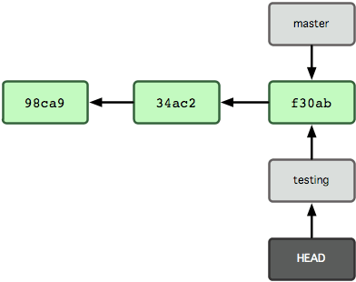
Git Branching - What a Branch Is(6)
HEAD points to another branch when you switch branches
Notes:
$ cd ../
$ git checkout testing
$ cd .git
$ ls
$ cat HEAD

Slide 18
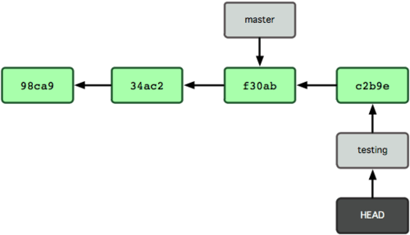
Git Branching - What a Branch Is(7)
The branch that HEAD points to moves forward with each commit
Notes:
$ cd ../
$ echo "some changes" > test.rb
$ git commit -a -m "made some changes"
$ cd .git
$ ls
$ cat HEAD
$ cat refs/heads/testing
$ cat refs/heads/master
$ git log | head

Slide 19
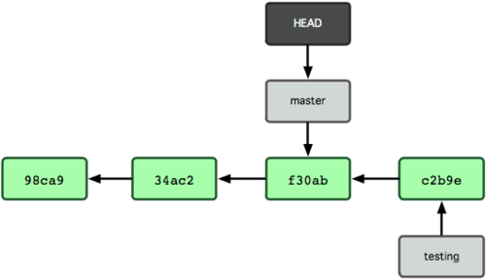
Git Branching - What a Branch Is(8)
HEAD moves to another branch on a checkout
Notes:
$ cd ../
$ git checkout master
$ cd .git
$ cat HEAD
$ cat refs/heads/master
$ git log | head
$ cat refs/heads/testing

Slide 20
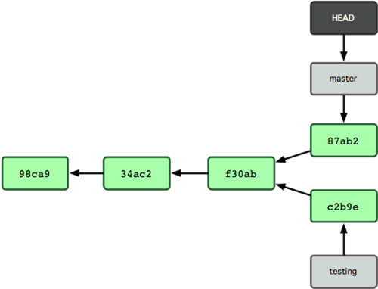
Git Branching - What a Branch Is(9)
The branch histories have diverged
Notes:
$ cd ../
$ echo “other changes" > test.rb
$ git commit -a -m "made other changes“
$ git log | head
$ cd .git
$ ls
$ cat HEAD
$ cat refs/heads/master
$ cat refs/heads/testing

Slide 21
Git Branching - Branch commands
git branch - list, create and delete branches
git checkout - switch to a new branch context
  Tracking Remote Branches
  git checkout --track origin/serverfix
  git checkout –b sf origin/serverfix
git merge - merge a branch context into your current one
git cherry-pick - apply the changes introduced by some existing commits
Notes:
[This is the Hard bone]-First through the normal branch op, then explain remote branch. (May review the Git Basics – Working with remotes)
git branch / git branch -v / git branch -a / git branch --no-merged / git branch --merged + git branch -d <mergedbranch>
git push (remote-alias) :(remote-branchname) delete a remote branch
git checkout -b <newbranch> <startpoint>
git merge <branchname> / git merge --no-ff
git cherry-pick

Slide 22
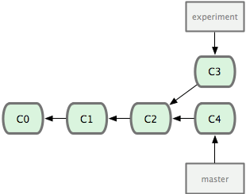
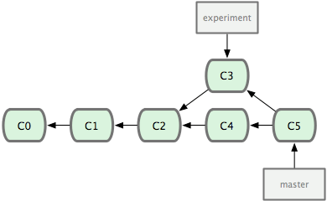
Git Branching - Rebasing(1)
In Git, there are two main ways to integrate changes from one branch into another: merge and rebase
$ git checkout master
$ git merge experiment
merge
Notes:
$ git checkout master
$ git merge experiment
$ git lg

Slide 23
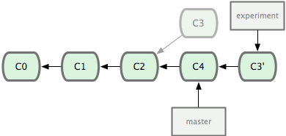
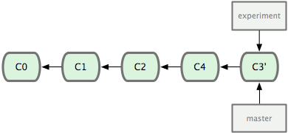
Git Branching - Rebasing(2)
Rebase & Fast-forward merge
$git rebase master experiment
$git checkout master
$git merge experiment
rebase
merge
Notes:
$ git checkout experiment
$ git rebase master
$ git checkout master
$ git merge experiment
git rebase [basebranch] [topicbranch]

Slide 24
Git Branching - Rebasing(2)
Rebase & Fast-forward merge
$git rebase master experiment
$git checkout master
$git merge experiment
rebase
merge
Notes:
$ git checkout experiment
$ git rebase master
$ git checkout master
$ git merge experiment
git rebase [basebranch] [topicbranch]

Slide 25
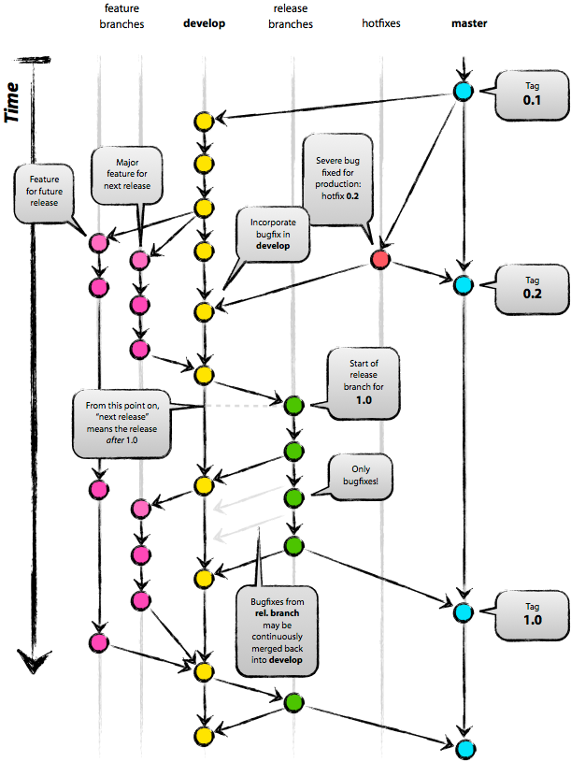
Git Branching - Git Branching model
A successful Git branching model

Slide 26
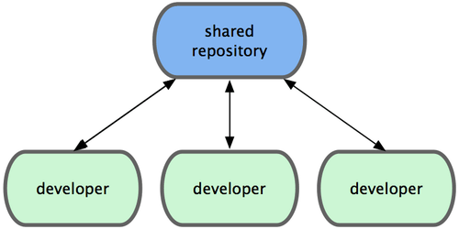
Git Workflows - Centralized Workflow
Notes:
This concept is true in Git as it is in Subversion (or any CVCS), and this model works perfectly in Git. – Small team use this workflow

Slide 27
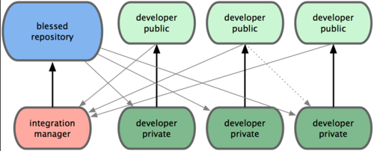
Git Workflows - Integration-Manager Workflow
Notes:
Github use this workflow
1. The project maintainer pushes to their public repository.
2. A contributor clones that repository and makes changes.
3. The contributor pushes to their own public copy.
4. The contributor sends the maintainer an e-mail asking them to pull changes.
5. The maintainer adds the contributor’s repo as a remote and merges locally.
6. The maintainer pushes merged changes to the main repository.

Slide 28
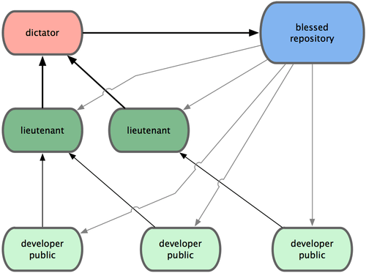
Git Workflows - Dictator and Lieutenants Workflow
Notes:
Linux kernel use this workflow
1. Regular developers work on their topic branch and rebase their work on top of master. The master branch is that of the dictator.
2. Lieutenants merge the developers’ topic branches into their master branch.
3. The dictator merges the lieutenants’ master branches into the dictator’s master branch.
4. The dictator pushes their master to the reference repository so the other developers can rebase on it.

Slide 29
Git on the server
Git use four major protocols to transfer data
  Local Protocol
  eg: $ git clone /opt/git/prj.git or $ git clone file:///opt/git/prj.git
  The SSH Protocol
  eg: $ git clone ssh://user@server/project.git
  or $ git clone user@server:project.git
  The Git Protocol
  eg: git clone git://someplace/repo.git
  The HTTP/S Protocol
    eg: git clone https://github.com/dorayo/dotfiles.git
    See Also
Creating Tags
  git tag –a v1.3 –m "my version 1.3"
  Showing Tag data along with commit
  git show v1.3
Tagging Later
git tag –a v1.2 –m 'version 1.2' [commit]
Sharing Tags
git push origin [tagname]

Slide 30
Git on the server – SSH for Centralized Workflow
Setting up the server
  Create a git user
  Create file /home/git/.ssh/authorized_keys
  Add user’s public keys
  Change user git's login shell to git-shell
  set up an empty repository by running git init with the --bare option
First developer Johns push the project onto the server
The other developers clone it down and push changes back
  see detail
  Generating SSH Public Key

Slide 31
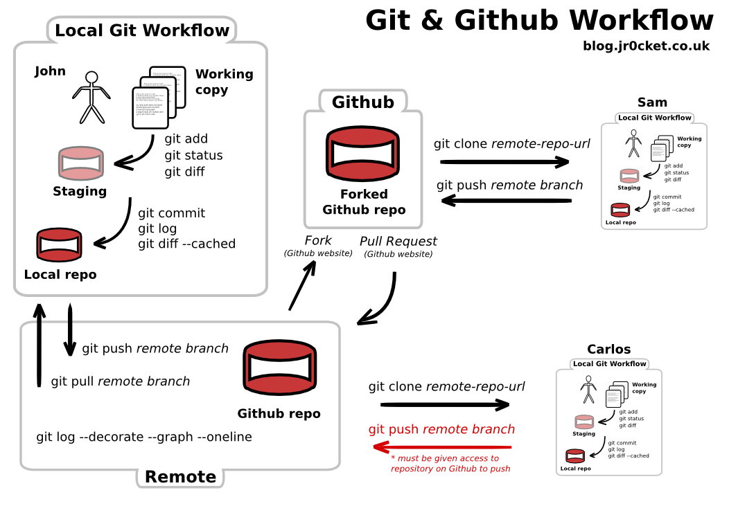
Git & Github

Slide 32

Git VS. SVN
why-is-git-better-than-svn
GitSvnComparision

Slide 33
Referrences
Book
  Pro Git http://git-scm.com/book
Blog
  Blog - Scott Chacon http://scottchacon.com/
Video
  Introduction to Git
Referrence
  Git Referrence http://gitref.org

Slide 34
The End & Thank You
When I say I hate CVS with a passion, I have to also say that if there are any SVN [Subversion] users in the audience, you might want to leave. Because my hatred of CVS has meant that I see Subversion as being the most pointless project ever started. The slogan of Subversion for a while was "CVS done right", or something like that, and if you start with that kind of slogan, there's nowhere you can go. There is no way to do CVS right.
--Linus Torvalds, as quoted in Wikipedia
Tech Talk: Linus Torvalds on git

